Slide 1
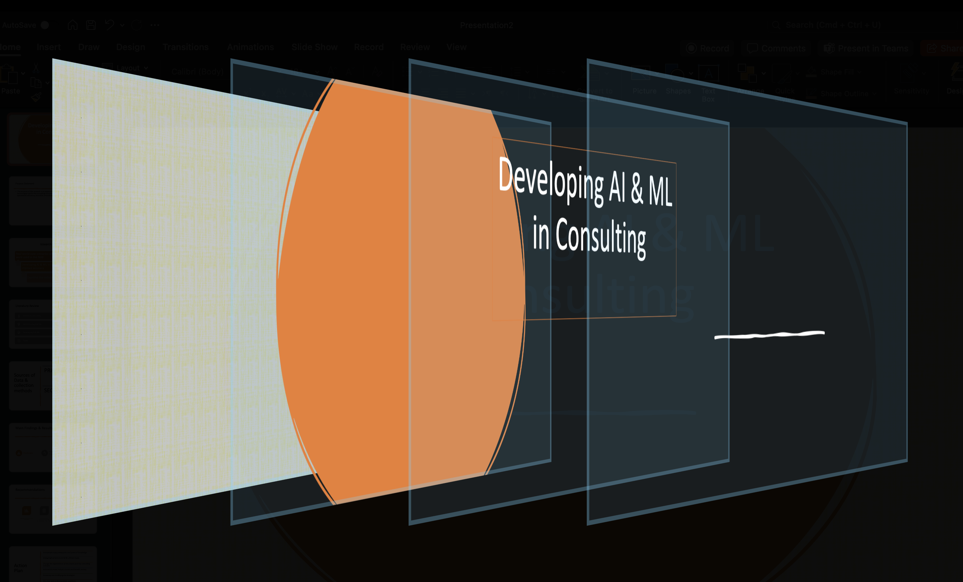

Slide 2
Purpose Statement
The purpose of this research is to explore the integration and advancement of AI and ML technologies within the consulting industry, aiming to enhance decision-making, improve operational efficiency, and drive innovation in consultancy practices.

Slide 3
Research Objectives
Real world case scenarios where ai & ml were used in the field
Developing AI & ML in consultation to improve accuracy
Examine the collected data

Slide 4
Literature Review
AI & ML in consulting
Deloitte using AI & ML
Developing AI & ML
Cases

Slide 5
Sources of Data & collection methods
PRIMARY DATA
SECONDARY DATA

Slide 6
Main Findings & Results
Challenges
Real world examples
Online resources & Contacts

Slide 7
Recommendations
Enhance Data Collection Methods
More ready data infrastructure and regulations within Jordan
Utilizing AI in general to up their game and stay in competition with other companies in the field
More robust computers with high computing power

Slide 8
Action Plan
incorporate many viewpoints and areas of knowledge
Giving high priority to AI & ML ethical issues
Change the expectations of the clients and the consulting industry
innovations meet industry norms and benefit society
Assessing and modifying the strategies
Ask clear and understandable questions
Seek for experts help

Slide 9
Any Questions?
Many Thanks
Yazan Khoury

